Slide 1
Notes:
Entered text
PROJECT DESCRIPTION
It is a web application, where employees can perform every
operation regarding their work. Employees can manage their work
records; Admins can see work records of all or particular
employees. This will be a role-based application- Admin and
Employee. Employee can check-in and check-out and can send daily
status via e-mail. Admin will be notified for check-in and check-out
and daily status from employees.
PROJECT ABSTRACT
It is a web application, where employees can perform every operation
regarding their work. Employees can manage their work records; Admins
can see work records of all or particular employees. This will be a role
based application- Admin and Employee. Employee can check-in and
check-out and can send daily status via e-mail. Admin will be notified for
check-in and check-out and daily status from employees. Admin’s Role
Can do login, Can see daily work records/statuses of employee(s), Able to
filter data according to date, year and month, Able to add remarks on
particular work record/status.
WEEKLY WORK
WEEK 1
Introduction to React.js: Started with an introduction to React.js technology, including an overview of the languages
used (HTML, CSS, JavaScript).
JavaScript Fundamentals: Covered variables, operators (arithmetic, assignment, comparison, logical, ternary), and
basic DOM concepts, understanding how HTML and JS files are connected.
String and Array Methods: Learned various string and array methods for manipulation and operations. Functions,
Arrow Functions, and Objects: Covered the fundamentals of functions, arrow functions, and object operations,
along with events and event listeners in JavaScript.
Projects and React.js Setup: Created small projects using HTML, CSS, and JavaScript, and then progressed to
installing and setting up React.js and Node.js. Started with creating a React app and printing text on it.
WEEKLY WORK
WEEK 2
Started with PROPS in react, image implementation, and Navigation in react (Re act Routing Dom), performing some
programs implementing these concepts.
Performing map and filter in react, understanding Events in react, Conditional Rendering, and and implementing
these concepts.
react Hooks- useState, useEffect, useRef, useNavigate.
Axios get() method (simply calling the API using get() method), Axios get using useEffect.
Started working on todo list project.
Entered text
(15/01/2024): Started with To-do App, Defining the requirement and creating an rough idea for
To-do List, Researching for how to take the input from the user and display using hook in react.
2. (16/01/2024): Researching for multiple data to enter in the todo list, after that finding the logic
for adding the delete button, Adding the update function.
3. (17/01/2024): After creating the To-do list which only adds the name and description entered
by the user which also contains the delete function and update function, now creating the
UI(complete designing) for To-do.
4. (18/01/2024): Going through the project (To-do List), Started with the Weather App –
Researching and gathering information for initiating the weather app, getting the API which
give the details of the current weather and implementing it through the axios to get the data and
by using the use-Effect to by default display the weather data automatically when the app is
started.
5. (19/01/2024): Researching for how to convert the data from Kelvin to Celsius because the data
which we are getting from the API is in Kelvin format.
Entered text
(15/01/2024): Started with To-do App, Defining the requirement and creating an rough idea for
To-do List, Researching for how to take the input from the user and display using hook in react.
2. (16/01/2024): Researching for multiple data to enter in the todo list, after that finding the logic
for adding the delete button, Adding the update function.
3. (17/01/2024): After creating the To-do list which only adds the name and description entered
by the user which also contains the delete function and update function, now creating the
UI(complete designing) for To-do.
4. (18/01/2024): Going through the project (To-do List), Started with the Weather App –
Researching and gathering information for initiating the weather app, getting the API which
give the details of the current weather and implementing it through the axios to get the data and
by using the use-Effect to by default display the weather data automatically when the app is
started.
5. (19/01/2024): Researching for how to convert the data from Kelvin to Celsius because the data
which we are getting from the API is in Kelvin format.
Entered text
So firstly, we have to fetch the data from the api using AXIOS an print it in the browser, after understanding that
how the data are formatted and stored in API. we had taken an useState [data, setdata] created an object in the
setdata, the object will be use to declare to all the fields such as (temp, temp_max, name, sunrise, sunset,
humidity and more) So this declared as the properties of the object, through these properties we can able to get
So firstly, we have to fetch the data from the api using AXIOS an
the data from the api and render it to our weather app. 2. (23/01/2024): Rendering the data on the weather app,
So now we have to get the data to be converted from Kelvin to Celsius, As per the given requirements we also
have to fetch the daily and hourly data from another API, and making some changes to the UI. Fetching the daily
weather data through API which contains Latitude and Longitude sections in which we have to set our variables
which we have created in the program.
After fetching the daily data we will also get the hourly data from that API, Now both the data hourly and daily are
gathered from that API but the data are in kelvin format so, we have to convert the data from kelvin to Celsius and
as per the requirement we have render only few data on our weather app because the daily and hourly data from
the lat and lon API contains 45-46 individual data so to do that we will use splice() method which will slice the
element from the array of data. after rendering some of the data on the console we have to convert the Kelvin
data into Celsius, so this rendered data is for a specific city. So till now all the data of a specific city is rendered in
console of our browser and now we will render the data on the actuall weather App. The useState which contains
the variable city, this ‘city’ variable we will be going to set in the city’s API like this ${city}.
And now will replace lat and lon variables in the api through which we can get the hourly and daily data
according to the user.
Implementing the current location feature by using the ‘navigator.geolocation’, implementing this users
can get the weather data as per their current location. And implementing the Fahrenheit In the weather
app where we can able to convert the data into Fahrenheit.

Slide 3
Project Presentation
This presentation provides an overview of the project and its weekly progress.

Slide 4
Project Description
It is a web application where employees can perform various workrelated operations.
Employees can manage their work records.
Admins can view work records of all or specific employees.
The application has rolebased access, with roles for Admin and Employee.
Employees can checkin and check-out and send daily status via e-mail.
Admins will be notified of checkin, check-out, and daily status updates from employees.

Slide 5
Project Abstract
It is a web application where employees can perform various workrelated operations.
Employees can manage their work records.
Admins can view work records of all or specific employees.
The application has rolebased access, with roles for Admin and Employee.
Employees can checkin and check-out and send daily status via e-mail.
Admins will be notified of checkin, check-out, and daily status updates from employees.
Admins can log in and view daily work records/statuses of employee(s).
Admins can filter data according to date, year, and month.
Admins can add remarks on specific work records/statuses.

Slide 6
Weekly Work - Week 1
Introduction to React.js: Overview of React.js technology and the languages used (HTML, CSS, JavaScript).
JavaScript Fundamentals: Covered variables, operators, and basic DOM concepts.
String and Array Methods: Learned various string and array methods for manipulation and operations.
Functions, Arrow Functions, and Objects: Covered the fundamentals of functions, arrow functions, and object operations.
Projects and React.js Setup: Created small projects using HTML, CSS, and JavaScript. Set up React.js and Node.js.

Slide 7
Weekly Work - Week 2
React Hooks: Covered useState, useEffect, useRef, and useNavigate.
Started with PROPS in React: Implemented props, image rendering, and navigation.
Performed map and filter in React, understood events and conditional rendering.
Axios get() method: Accessed APIs using get() method and useEffect.
Started working on a todo list project.

Slide 10
Creating To-do App and Weather App
This presentation covers the process of creating a To-do app and a Weather app using React.

Slide 11
To-do App - Defining Requirements
Creating a rough idea for To-do List
Started with To-do App
Defining the requirements
Researching how to take input from the user and display using hooks in React

Slide 12
To-do App - Adding Functionality
Researching how to enter multiple data in the todo list
Finding the logic for adding a delete button
Adding an update function

Slide 13
To-do App - Designing UI
Adding styling and layout
Creating the UI for the To-do app
Complete designing of the UI

Slide 14
Weather App - Getting Started
Researching and gathering information for initiating the weather app
Finding an API to get the details of the current weather
Implementing API using axios to retrieve data
Using useEffect to automatically display weather data when the app is started

Slide 15
Weather App - Converting Temperature
Exploring different methods and formulas for temperature conversion
Researching how to convert data from Kelvin to Celsius

Slide 16
Thank you. Please feel free to ask any questions. 😄

Slide 17
To-do and Weather App Presentation
This presentation provides an overview of the development process for a To-do and Weather App

Slide 18

(15/01/2024): To-do App - Defining Requirements
Researching how to take input from the user and display using hooks in React
Defining the requirements for the To-do App
Creating a rough idea for the To-do List

Slide 19

(16/01/2024): To-do App - Adding Functionality
Implementing the update function
Researching how to enter multiple data in the todo list
Finding the logic for adding a delete button

Slide 20

(17/01/2024): To-do App - UI Design
Creating a complete design for the Todo App
Designing the user interface for the app

Slide 21
(18/01/2024): Weather App - Research and Implementation
Implementing the weather app using axios and useEffect
Researching and gathering information for initiating the Weather App
Getting the API for current weather details

Slide 23
Creating Weather App
Building a weather app using API data

Slide 24
Introduction
Setting up state for data
Fetching data from API using AXIOS
Understanding the data format
Rendering data on weather app

Slide 25
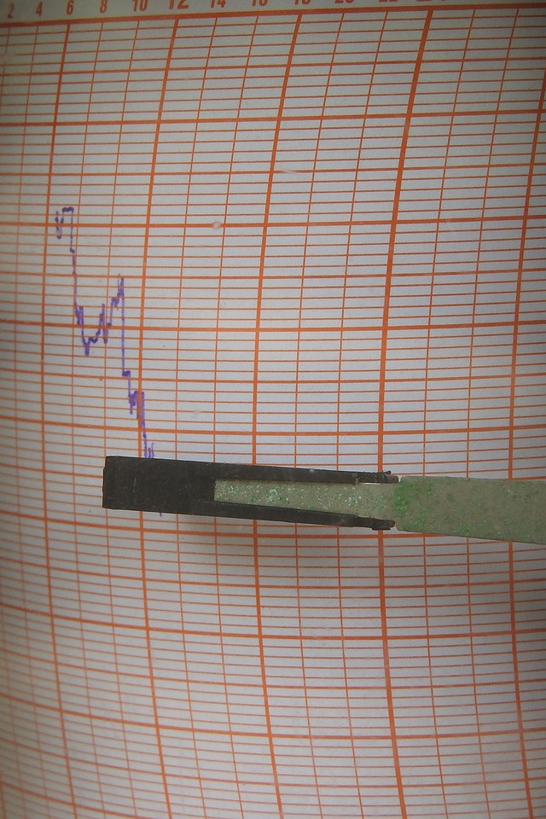
Rendering Data
Converting data from Kelvin to Celsius
Fetching daily and hourly data from another API
Making UI changes
Setting variables for latitude and longitude

Slide 26
Data Manipulation
Rendering specific data on weather app
Slicing data using splice() method
Converting Kelvin data to Celsius
Rendering data for a specific city

Slide 27

Additional Features
Implementing Fahrenheit conversion
Implementing current location feature
Using navigator.geolocation

Slide 28
Thank you for your time 😊

Slide 29
Creating a Weather App
This presentation will guide you through the process of creating a weather app using API data and converting temperature units.

Slide 30

Fetching Data from API
Understand the data format and structure
Use AXIOS to fetch data from the API
Print the data in the browser

Slide 31

Rendering Data on Weather App
Create an object with useState to store the data
Declare properties of the object for temperature, name, sunrise, sunset, humidity, etc.
Render the data on the weather app

Slide 32

Converting Kelvin to Celsius
Convert data from Kelvin to Celsius
Fetch daily and hourly data from another API
Make changes to the UI

Slide 33

Implementing Additional Features
Fetch daily and hourly data specific to a city
Implement current location feature using navigator.geolocation
Convert data to Fahrenheit

Slide 34
Thank you for your time 😊

